Slide 1

AMAZON

Slide 2
Topics That are used in Amazon Project

Slide 3
HTML:
HTML stands for Hyper Text Markup Language
•HTML is the standard markup language for creating Web pages
•HTML describes the structure of a Web page
•HTML consists of a series of elements
•HTML elements tell the browser how to display the content
•HTML elements label pieces of content such as
• "this is a heading",
• "this is a paragraph",
"this is a link", etc.
<!DOCTYPE html> <html> <head> <title>Page Title</title> </head> <body> <h1>My First Heading</h1> <p>My first paragraph.</p> </body> </html>

Slide 4
CSS:
CSS stands for Cascading Style Sheets
•CSS describes how HTML elements are to be
displayed on screen, paper, or in other media
•CSS saves a lot of work.
•It can control the layout of multiple web pages all at once
•External stylesheets are stored in CSS files
•CSS is used to define styles for your web pages,
including the design, layout and variations in display
for different devices and screen sizes.
body { background-color: lightblue; } h1 { color: white; text-align: center; } p { font-family: verdana; font-size: 20px; }

Slide 5
JAVA SCRIPT:
•JavaScript is the world's most popular programming
language.
•JavaScript is the programming language of the Web.
•JavaScript Can Change HTML Content
•JavaScript accepts both double and single quotes
•JavaScript Can Change HTML Attribute Values
•JavaScript Can Change HTML Styles (CSS)
•JavaScript Can Hide HTML Elements
•JavaScript Can Show HTML Elements
<html>
<head>
<script type = "text/java script">
function fun() {
alert ("This is an alert dialog box");
}
</script>
</head>
<body>
<p> Click the following button to see the effect </p>
<form>
<input type = "button" value = "Click me" onclick = "fun();" />
</form>
</body>
</html>

Slide 6
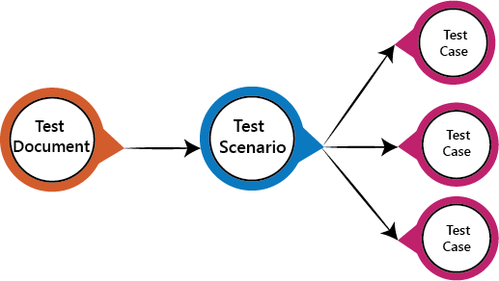
Test Scenario
The test scenario is a detailed document of test cases that cover end to end functionality of a software application in liner statements. The liner statement is considered as a scenario. The test scenario is a high-level classification of testable requirements. These requirements are grouped on the basis of the functionality of a module and obtained from the use cases.
In the test scenario, there is a detailed testing process due to many associated test cases. Before performing the test scenario, the tester has to consider the test cases for each scenario.
In the test scenario, testers need to put themselves in the place of the user because they test the software application under the user's point of view. Preparation of scenarios is the most critical part, and it is necessary to seek advice or help from customers, stakeholders or developers to prepare the scenario.

Slide 7
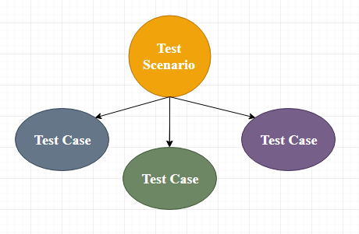
Test Case
The test case is defined as a group of conditions under which a tester determines whether a software application is working as per the customer's requirements or not. Test case designing includes preconditions, case name, input conditions, and expected result. A test case is a first level action and derived from test scenarios.

Slide 8
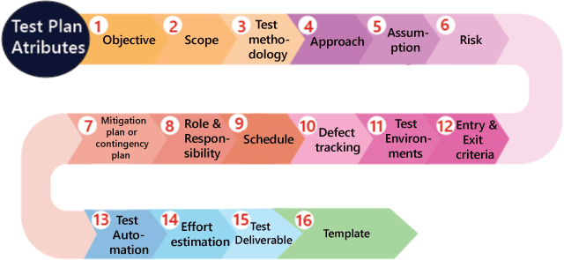
Test Plan
A test plan is a detailed document which describes software testing areas and activities. It outlines the test strategy, objectives, test schedule, required resources (human resources, software, and hardware), test estimation and test deliverables.
The test plan is a base of every software's testing. It is the most crucial activity which ensures availability of all the lists of planned activities in an appropriate sequence.
The test plan is a template for conducting software testing activities as a defined process that is fully monitored and controlled by the testing manager. The test plan is prepared by the Test Lead (60%), Test Manager(20%), and by the test engineer(20%).

Slide 9
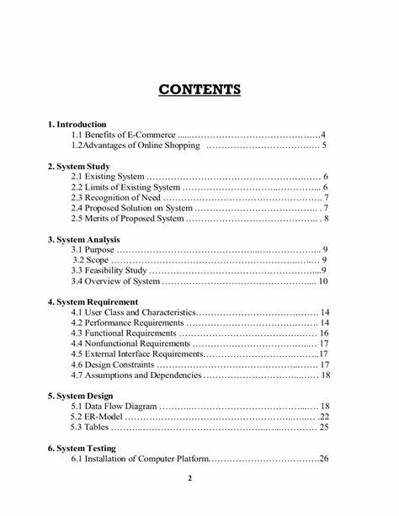
SRS DOCUMENT:
A software requirements specification (SRS) is a document that describes what the software will do and how it will be expected to perform. It also describes the functionality the product needs to fulfill all stakeholders (business, users) needs.

Slide 10
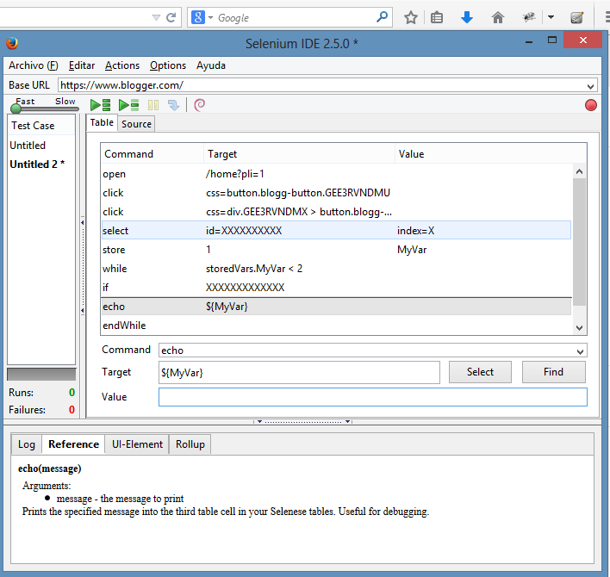
Selenium Integrated Development Environment (IDE)
Selenium IDE (Integrated Development Environment) is an open source web automation testing tool under the Selenium Suite. Unlike Selenium WebDriver and RC, it does not require any programming logic to write its test scripts rather you can simply record your interactions with the browser to create test cases. Subsequently, you can use the playback option to re-run the test cases.
Perhaps, creating test cases on Selenium IDE does not require any programming language but when you get to use selenese commands like runScript, a little knowledge prior to JavaScript would prove beneficial for you to understand the concepts more clearly.

Slide 11
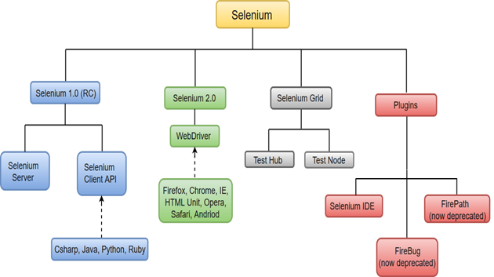
Selenium WebDriver
Selenium WebDriver is the most important component of Selenium Tool's Suite. The latest release "Selenium 2.0" is integrated with WebDriver API which provides a simpler and more concise programming interface.

Slide 12


